Slide 1
Business Intelligence
KDD

Slide 2



Knowledge Discovery in Databases
KDD is the automatic extraction of non-obvious, hidden knowledge from large volumes of data.
10⁶-10¹² bytes:
we never see the whole
data set, so will put it in
the memory of computers
What is the knowledge?
How to represent
and use it?
Then run Data
Mining algorithms

Slide 3



Data, Information, Knowledge
We often see data as a string of bits, or numbers and symbols, or “objects” which we collect daily.
Information is data stripped of redundancy and reduced to the minimum necessary to characterize the data.
Knowledge is integrated information, including facts and their relations, which have been perceived, discovered, or learned as our “mental pictures”.
Knowledge can be considered data at a high level of abstraction and generalization.

Slide 4
The KDD Process
Pattern Evaluation
Data Mining
Task-relevant Data
Data Warehouse
Selection
Data Cleaning
Data Integration
Databases

Slide 5
Main Fields
Statistics
[data warehouses:
integrated data]
Infer info from data
(deduction & induction, mainly numeric data)
[OLAP: On-Line
Analytical Processing]
KDD
Databases
Machine Learning
Store, access, search, update data (deduction)
Computer algorithms that improve automatically through experience (mainly induction, symbolic data)

Slide 6
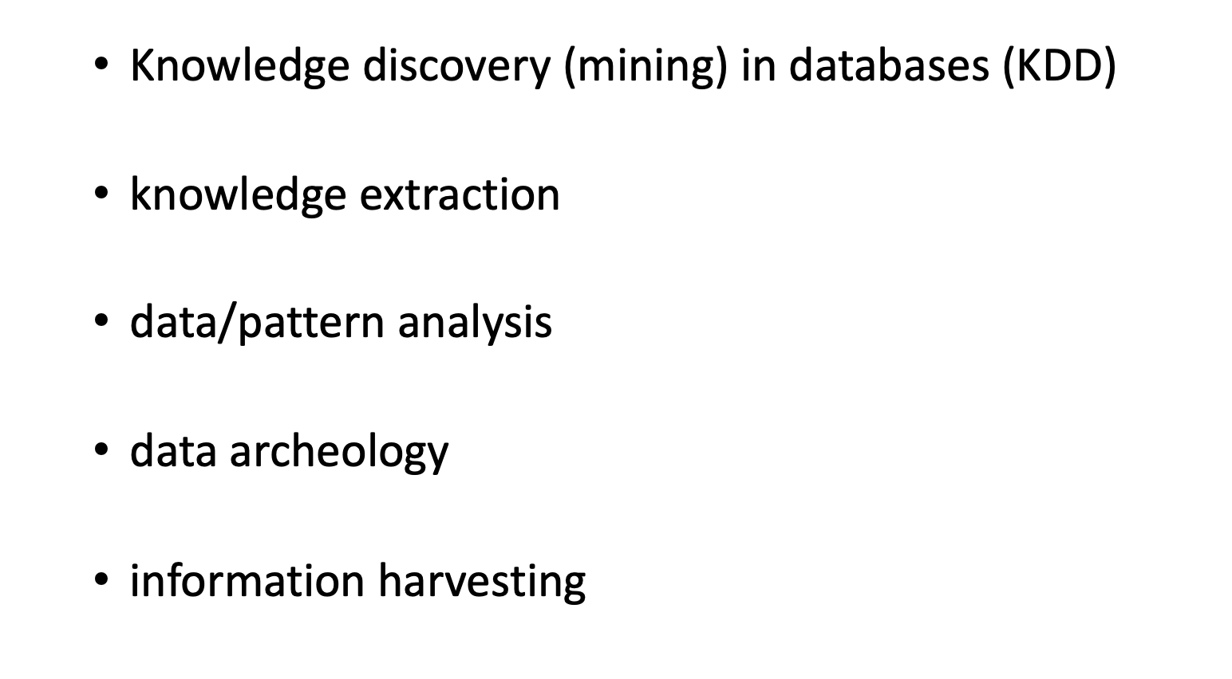
Data Mining

Slide 7
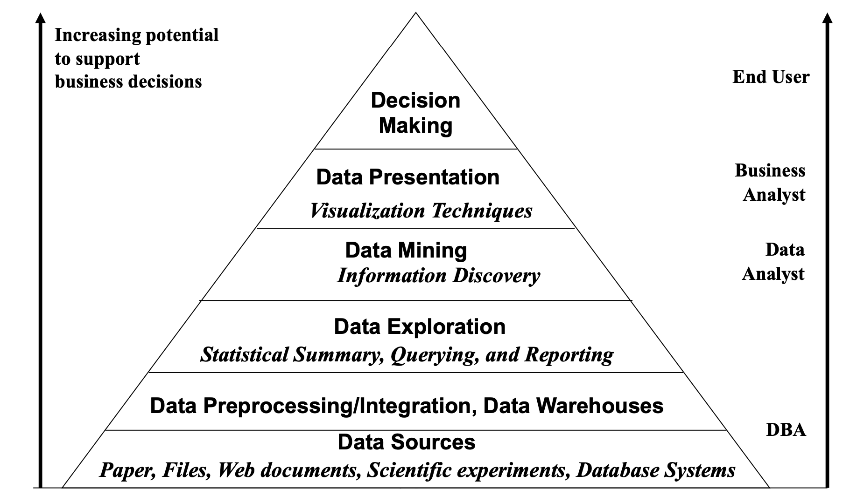
Data Mining

Slide 8
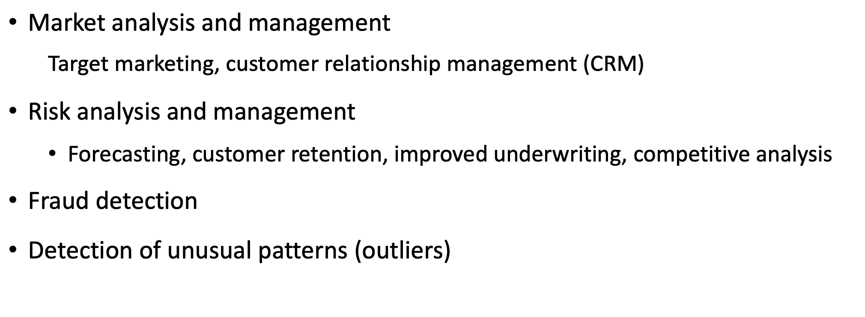
Applications

Slide 9
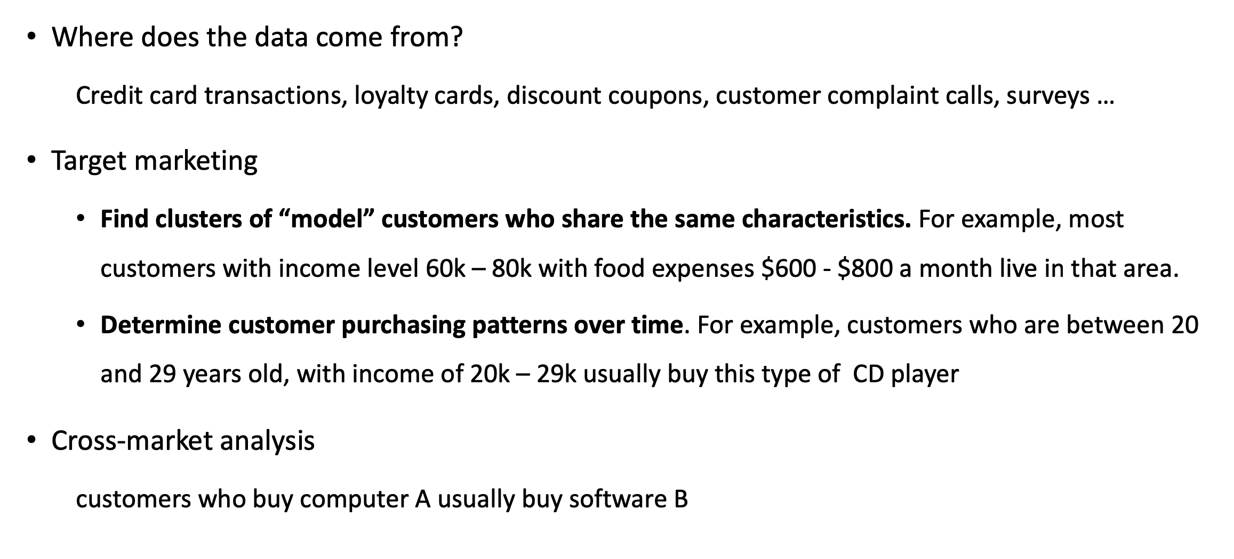
Market Analysis

Slide 10
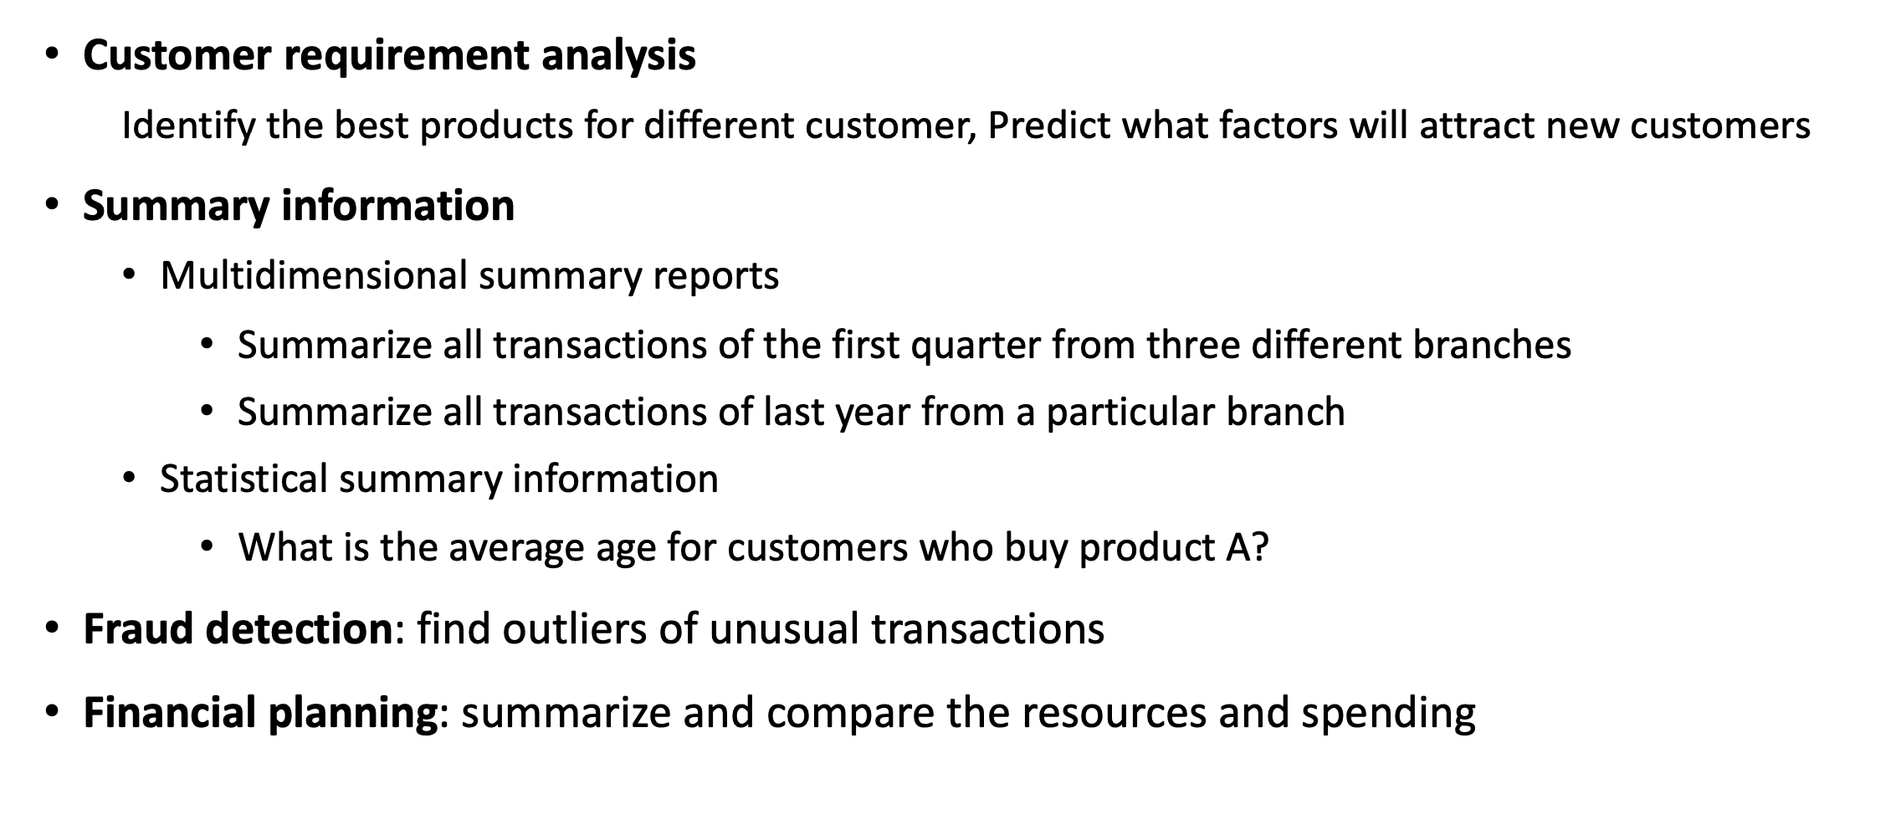
Market Analysis

Slide 11
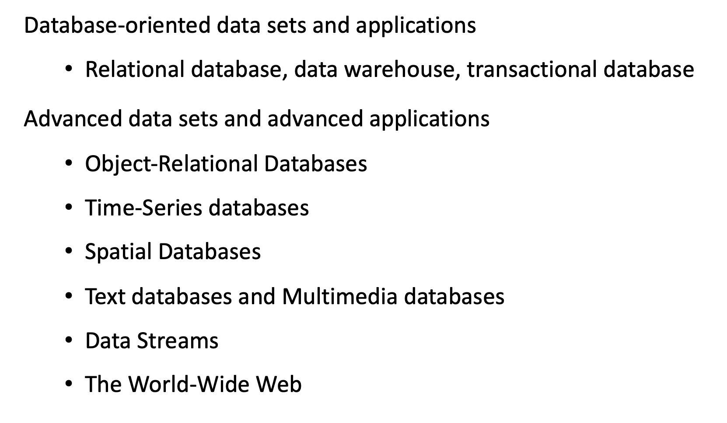
Types of Data

Slide 12
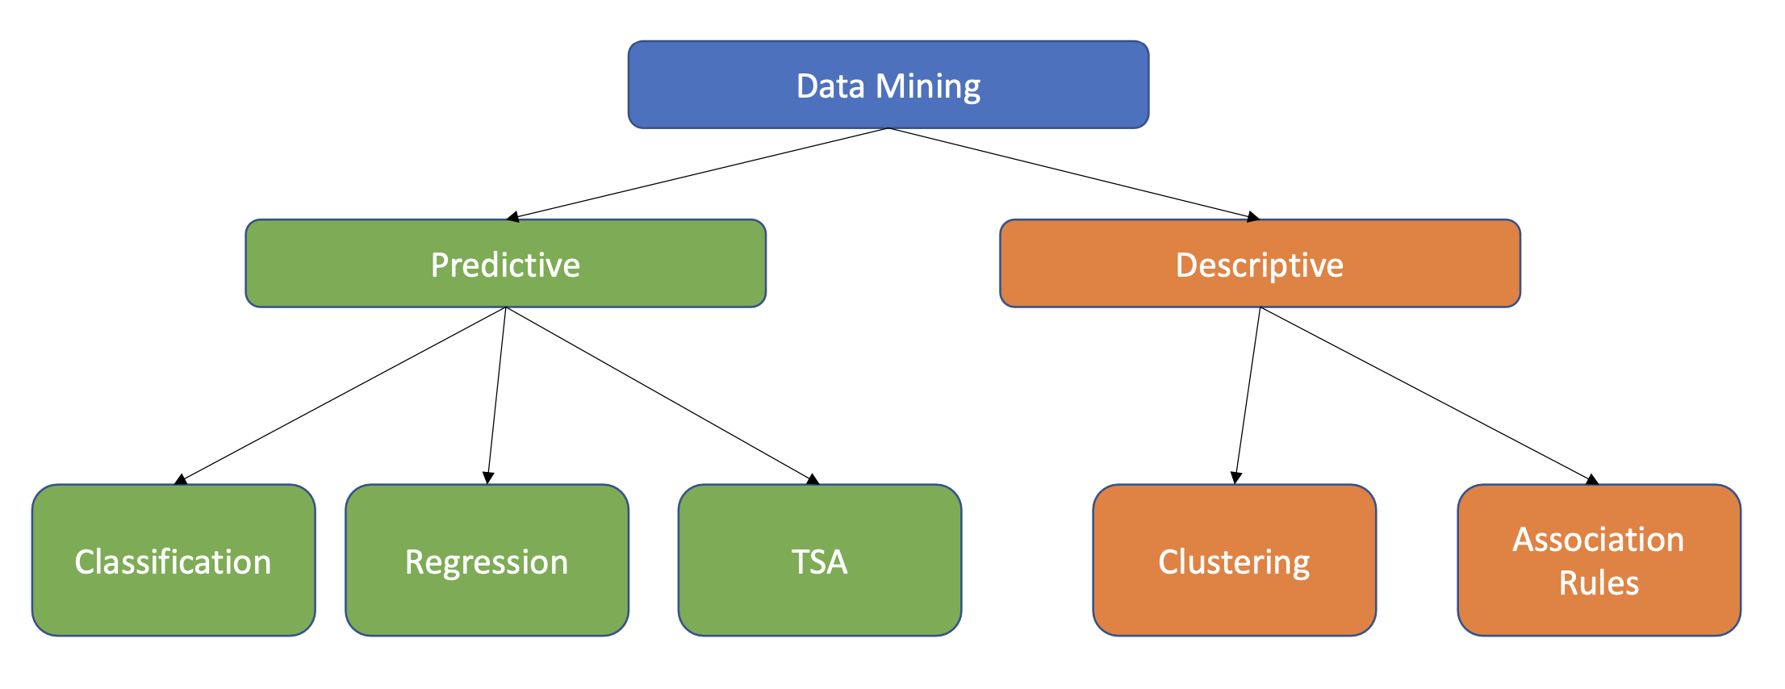
Data Mining Models

Slide 13
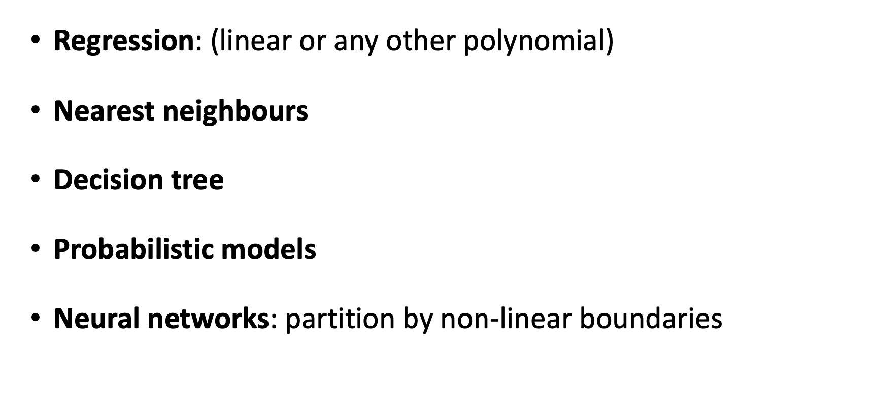
Data Mining Models - Predictive

Slide 14
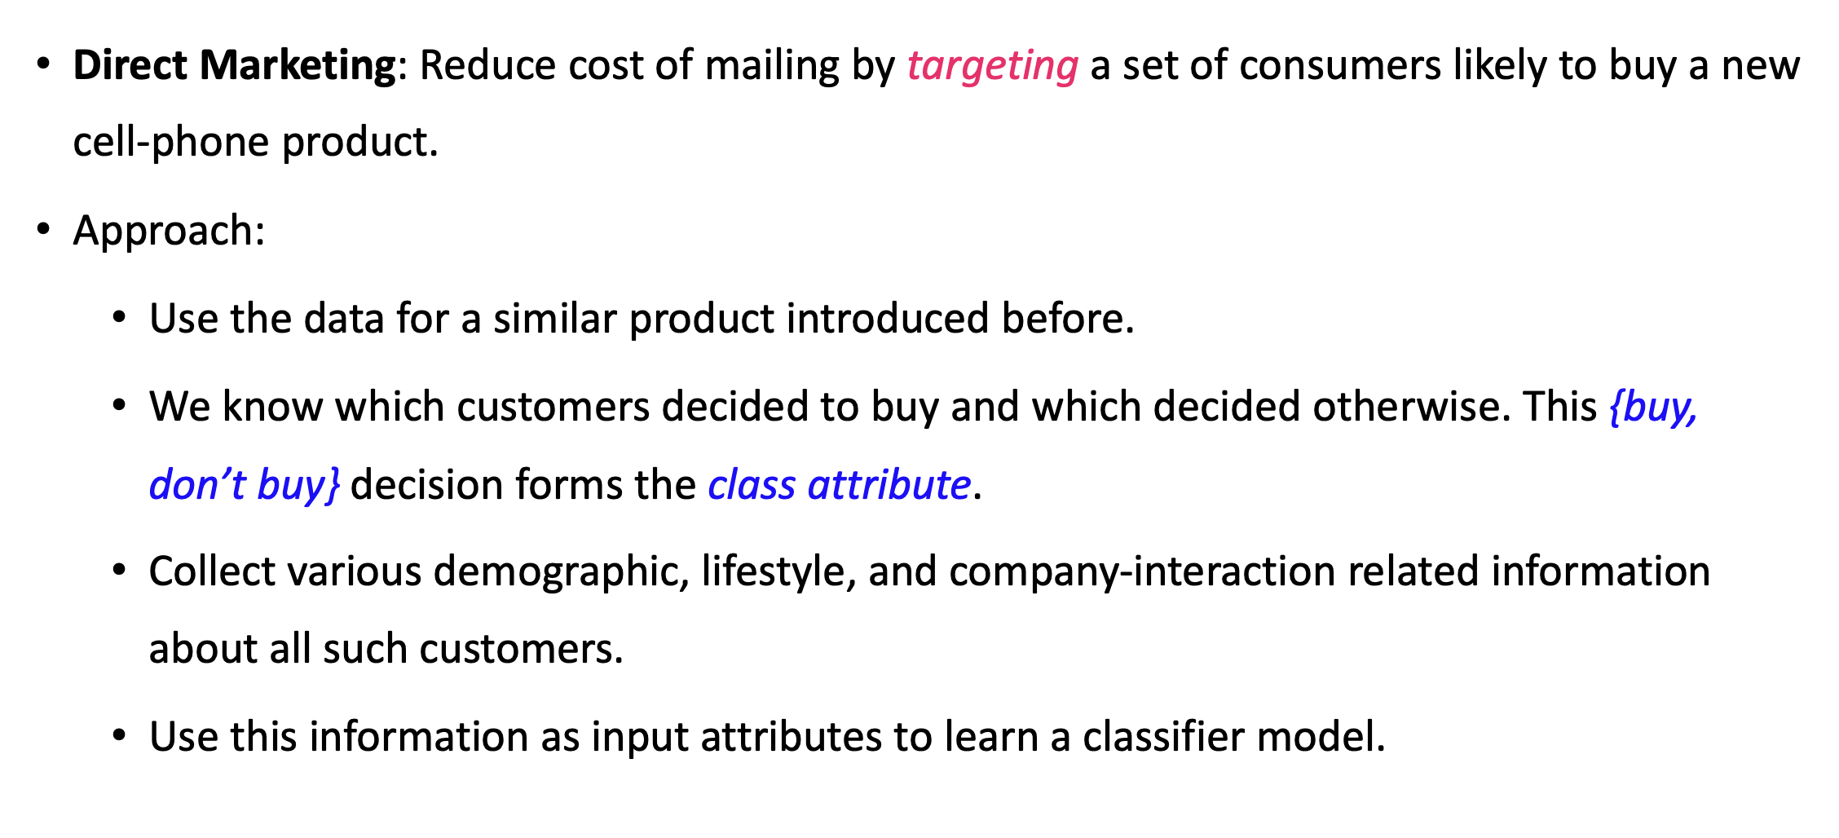
Data Mining Models - Predictive

Slide 15
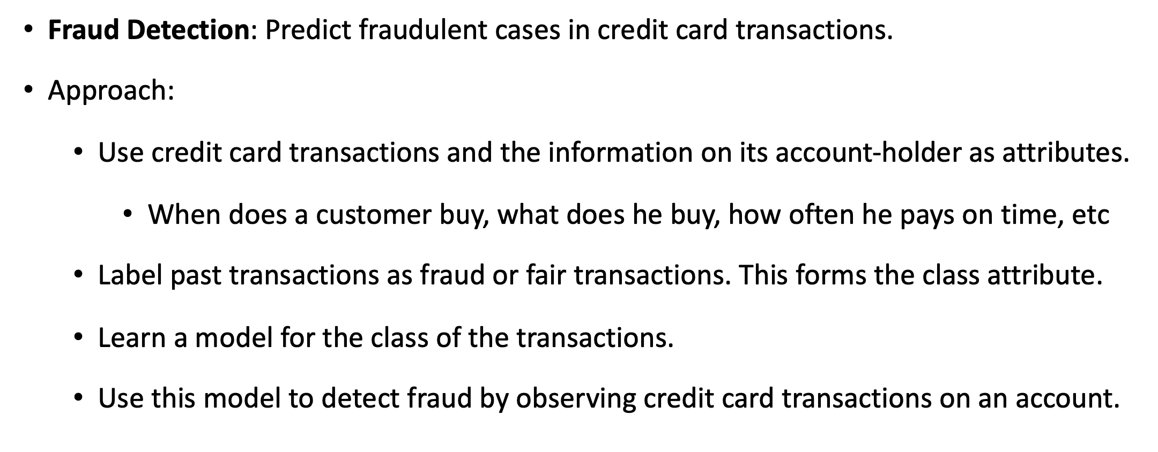
Data Mining Models - Predictive

Slide 16
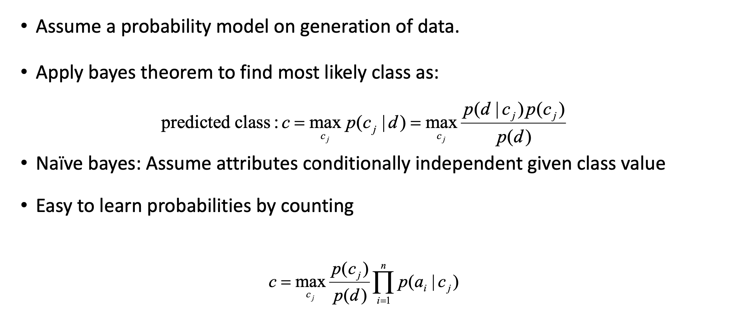
Data Mining Models – Bayesian Learning

Slide 17
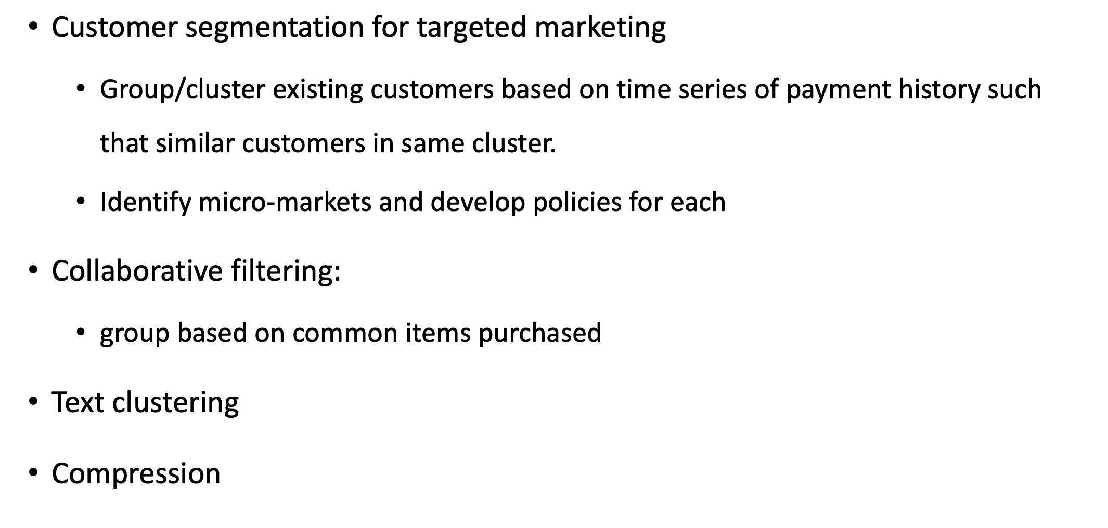
Data Mining Applications - Descriptive

Slide 18
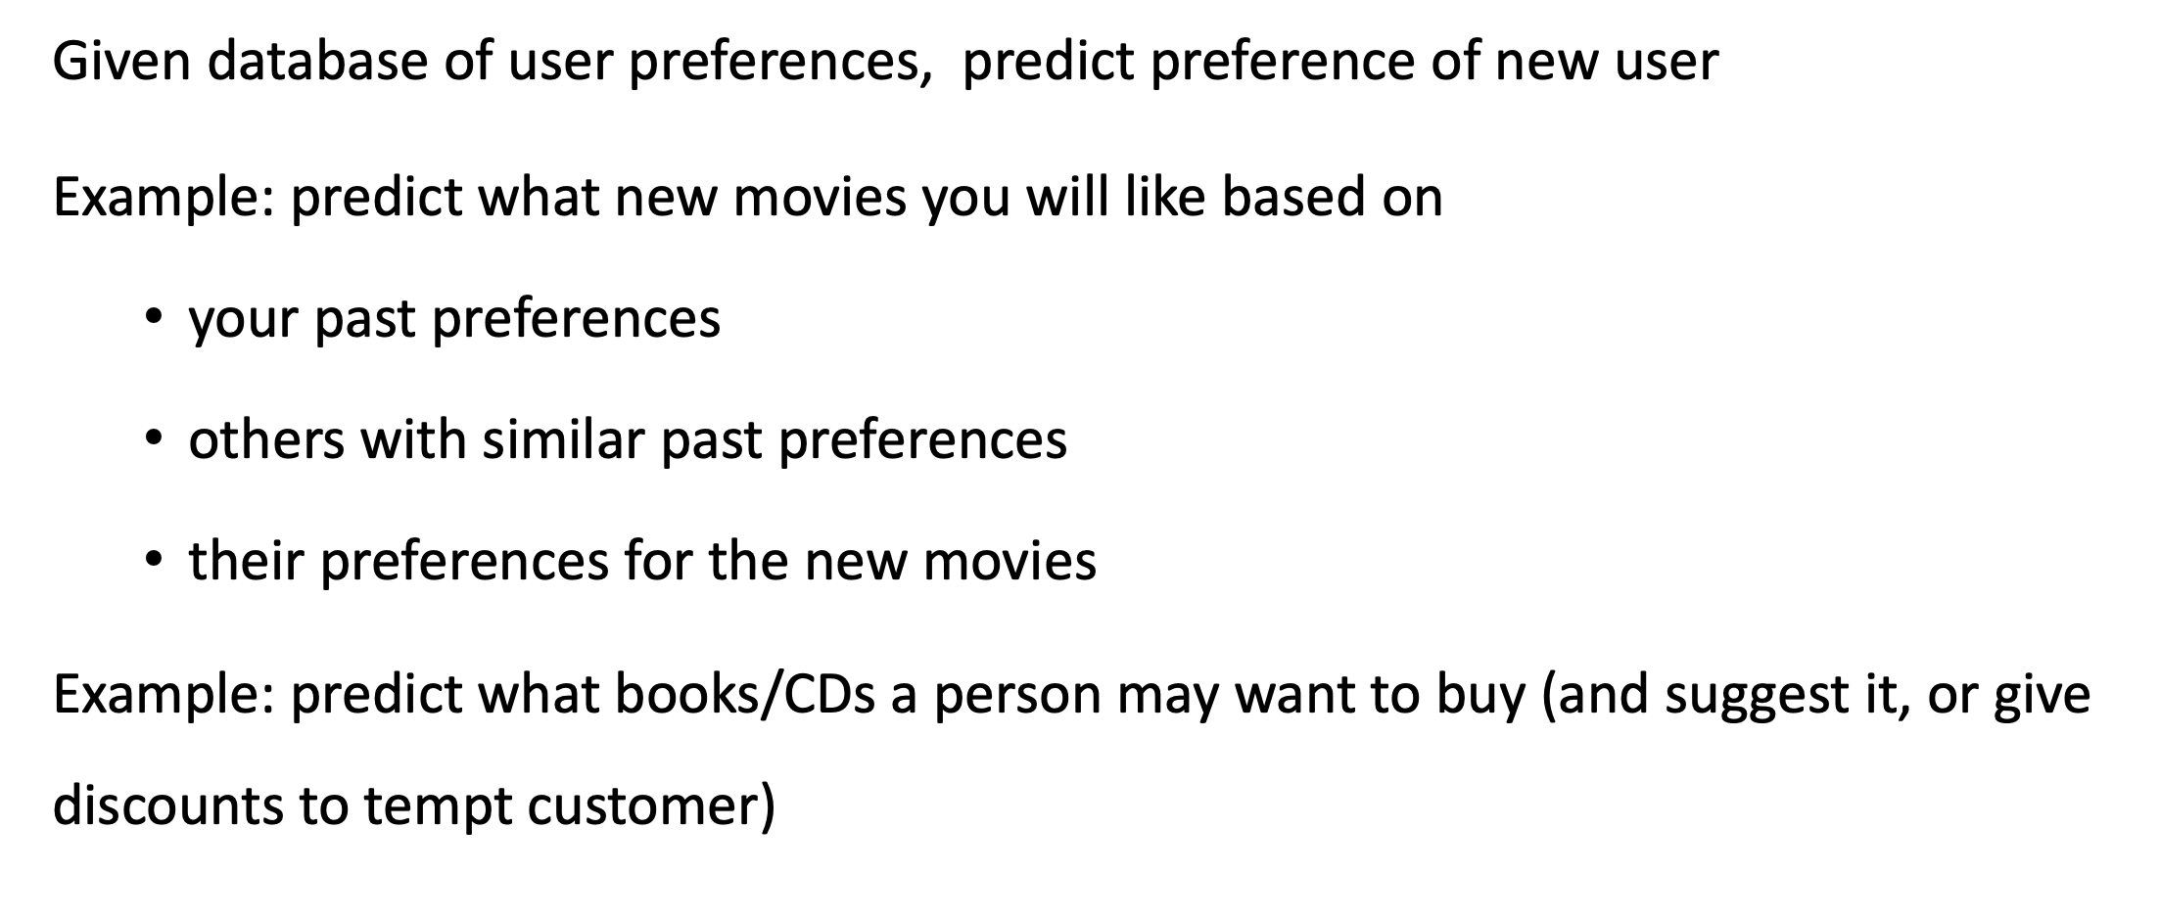
Data Mining Applications – Collaborative Filtering

Slide 19
Data Mining Techniques

Slide 20
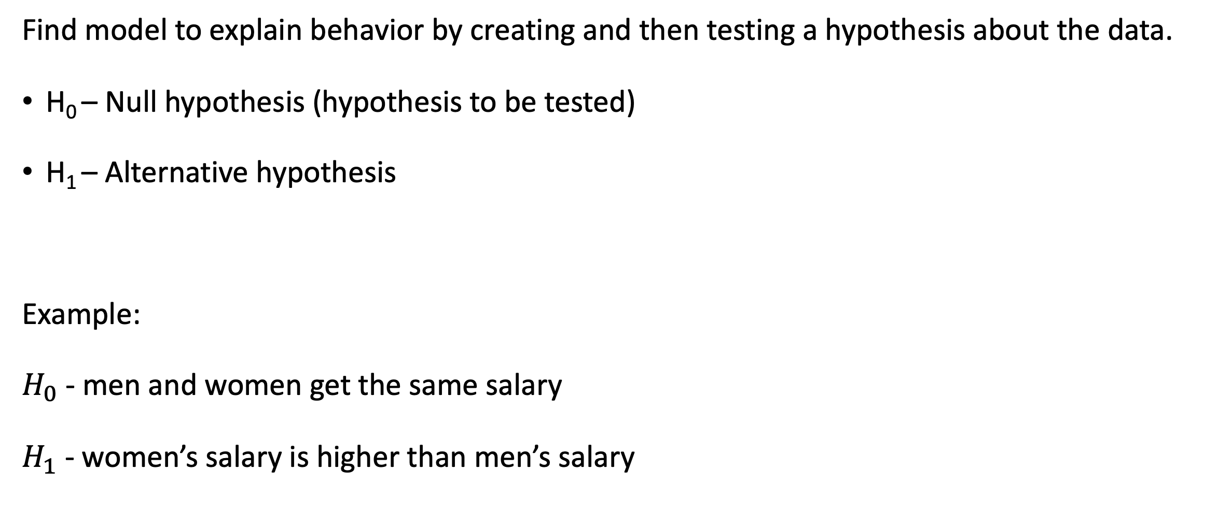
Hypothesis Testing

Slide 21
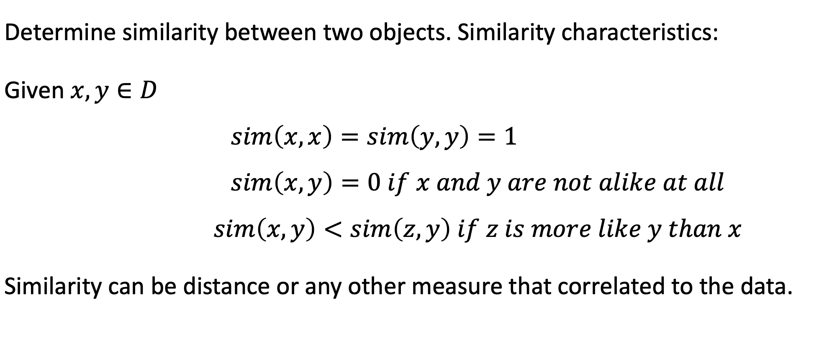
Similarity Measures

Slide 22
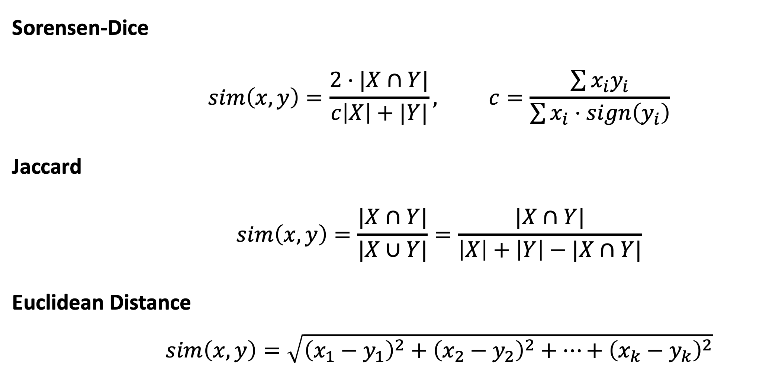
Similarity Measures

